Slide 1


Slide 2
COURSE INFORMATION EVENING
VCE/VCAL 2022
YEAR 11 and 12

Slide 3
Welcome
Key contacts
YEAR 11/12 Coordinators: Marie O’Connor and Stacey Sutton
VCAL Coordinator: Donna Gregg
Careers Counsellor: Sue Sly

Slide 4
Purpose of this PowerPoint– starting to answer the questions
  What are the VCE, VCAL, VET in the Schools?
  what are the key terms you will need to understand?
  What are the roles of the Year 11 and 12 coordinators and the Careers Counsellor?
  How do you choose the ‘right’ subjects?

Slide 5
The step up to VCE
Home Preschool
        Primary School
        Secondary College

Slide 6
The next step
Now…. the next step up the ladder…..
………. from Year 10 to Year 11.
- the biggest step your child will will make at secondary
school.

Slide 7
The College can help you
We work for
► students who wish to use their VCE as a way to tertiary education
► students who are looking for apprenticeships, traineeships on the way to meaningful employment

Slide 8
Why study VCE/VCAL at Ouyen P12?
Small classes
Availability of Year 12 subjects in Year 11 and Year 11 subjects in Year 10
Experienced teachers
Good facilities
Support from staff both in *subject areas* and in *student welfare*

Slide 9
The result?
Over the past five years
The majority of our students have gone on to either tertiary education or meaningful employment.

Slide 10
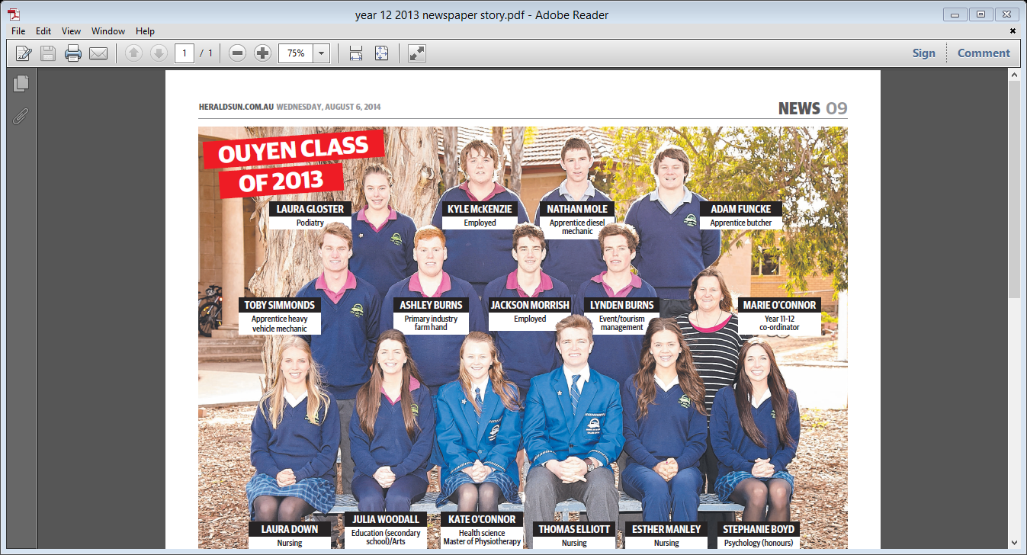

Slide 11
Key terms
1. VCAA – Victorian Curriculum & Assessment Authority - The central body that runs the VCE/VCAL
It sets the rules for achieving certificates
It is responsible for the final study scores (for Unit 3 and 4 subjects)
VTAC – Victorian Tertiary Admissions Centre
(SATAC in S.A.) VTAC calculates the ATAR and makes university offers
Australian Tertiary Admission Rank (ATAR)
the score that gets you into university . Students are ranked by how well they do in Year 12 (3/4) units.

Slide 12
Key terms
2. Unit - this lasts for one semester
3. Semester - this is half a year
so a Year 11 student will complete Unit 1 & Unit 2 English during the year
4. VCE - the Victorian Certificate of Education
This is usually attempted over two or three years
To gain the certificate the student must satisfactorily complete at least 16 units

Slide 13
As part of the minimum of 16 units, students need at least:
three units of English (from Units 1,2,3 & 4)
three other subjects at Unit 3/4 level
VET units completed in school and through SBAs* can be included in the 16 units
Each unit has learning outcomes.
These are what you must know or be able to do by the time you have finished a unit.

Slide 14
SATISFACTORY COMPLETION (S)
To gain an S for a unit you must know or be able to do what the unit requires.
T o get the VCE you must gain at least 16 Ss
GRADES
You will also be awarded grades for the work done in each unit but only at Unit 3 and 4 level. All grades at unit 1 and 2 level are internal.
VCAL – the Victorian Certificate of Applied Learning – more about this later.

Slide 15
If you do the work – what will you get from the VCAA or VTAC?
At the end of Year 11:
an S in each Unit 1 and 2 when the student has satisfied (showed knowledge &understanding of ) the outcomes.
Some students will also have 2 Ss for a Unit 3/4 study and a study score out of 50. (Only Unit 3/4 studies receive study scores towards the ATAR)

Slide 16
Students may have part or all of a VET certificate or SBA
or Students may have a VCAL certificate

Slide 17
Unit 3/4 Grades, Study Scores & ATARS
Grades and study scores - under the control of the VCAA. VTAC calculates the ATAR.
VCAA only gives grades to Unit 3/4 studies
Coursework/tasks ⇒ grades ⇒compared with other students doing that study ⇒ score/50 ⇒study scores for up to 6 of the students’ 3/4 studies combined and compared with results of all Year 12 students by VTAC ⇒ATAR.

Slide 18
COURSEWORK/TASKS ⇒ GRADES
GRADES ⇒ STUDY SCORE
(out of 50 for each completed Unit 3/4 study)
eg grades of A, A, A+ might convert to a study score of 40 for English - this would put you in the top 9%
The study score shows how well the student has done compared with other students doing that subject.
English + next top three + 10% of 5th and 6th
⇒ ATAR

Slide 19
This score is used to rank your performance in the VCE in relation to all other students who completed the course in the same year. That is, it gives you a relative position.
The highest ATAR you can achieve is 99.95.

Slide 20
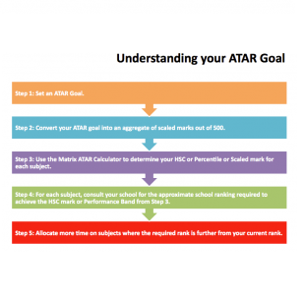

Slide 21
As your ATAR is a ranking you can look at this this way.
If you get a 60 ATAR it puts you in the top 40 percent of the state.
75 puts you in the top 25 percent.
80 in the top 20 percent
90 in the top 10 percent
96 in the top 4 percent etc

Slide 22
What is an ATAR used for?
University courses often have an ATAR score that is used as a cut-off.
Students must achieve this score (or close to it) to obtain entry into the course.
For example the ATAR needed to be accepted into a teaching course last year was 70.
The ATAR needed to be accepted into nursing at Latrobe in Melbourne was 65 but in Mildura it was 57.

Slide 23
The ATAR for physiotherapy at Latrobe University was 95 in Bendigo and 97 in Melbourne.
Sport and Exercise Science was 66.
The ATAR score may be used on its own as a selection tool for entry into courses; it is also often used in conjunction with other selection criteria that may include prerequisite subjects, interview and folio presentation.

Slide 24
Grades, Study Scores & ATAR
Student | Subjects | Grades | Study Scores | ENTER
A | English Accounting Biology Fur.Maths Psychology | A, A, A C+,B+,B B, A, D+ A, A, B+ B, A, A | 38 30 30 37 34 | 74
B | English Biology History Leg. Studies Ma. Methods Psychology | A+, A+, A A, A+, A A, A+, B A+, A+, A B+, B, B+ A+, A+, A+ | 43 38 34 39 32 46 | 94

Slide 25
VTAC (Victorian Tertiary Admissions Centre) has further information on how ATARs and scaling operate.
https://www.vtac.edu.au/atar-scaling-guide-2022.html
https://www.youtube.com/watch?v=V5WoA2T4H3g

Slide 26
How to choose your subjects
Where do you want to be in two years time?
What do you need to get into that course or training? (prerequisites)
What are you good at ?
What do you like?
Do you need to consider doing a Year 12 subject in Year 11?

Slide 27
The worst reasons are because my friends are doing that subject, I like that teacher or because I think it will be easy – no Year 11 subject is easy.
Below is a link from VTAC (Victorian Tertiary Admissions Centre) you may like to watch.
https://www.youtube.com/watch?v=cE0ImGZSf_g

Slide 28
If your focus is employment?
We work continuously with employers locally and in Sunraysia to place students in relevant employment.
Our Careers Counsellor works throughout the year to give students every opportunity to find the right work or training

Slide 29
Not everyone wants university
VET in schools- vocational (job related) education within the VCE structure.
school based apprenticeships (SBAs) and part time apprenticeships
These are possible pathways for students looking at apprenticeships and traineeships
Both can contribute Ss for completion of the VCE and VCAL

Slide 30
VET in Schools
In 2021 Ouyen P-12 College will be offering a range of VET in schools subjects both at Ouyen P-12 College and through Mildura TAFE.
One subject VET Auto will be taught at Ouyen while students will have the chance to enrol in a number of VET courses delivered from Mildura.

Slide 31
VET in Schools
A handout outlining the VET in schools subject available in Mildura is on our website.
It is important to note that only one VET subject from Mildura can be chosen however students can also enrol in VET Auto which is taught at the College.

Slide 32
If students are interested in the VET subjects they should see Mrs O’Connor or Mrs Sly for further information.
The classes in Mildura will run from 9am to 3pm on a Friday.

Slide 33
Another Option - VCAL
In 2022 the College will offer Intermediate and Senior VCAL - hands-on alternatives to the VCE
VCAL gives practical work-related experience together with literacy and numeracy skills.

Slide 34
VCAL
The Victorian Certificate of Applied Learning (VCAL) is a 'hands on' option for students in Years 11 and 12.
the VCAL is a recognised senior qualification.
It does not however provide students with an ATAR and so an avenue to University

Slide 35
Who chooses VCAL?
Students who do the VCAL are more likely to be interested in going on to training at TAFE, doing an apprenticeship, or getting a job after completing Year 12.
students work with the VCAL and Careers Coordinators to design a study program that suits their interests and learning needs.

Slide 36
What does a VCAL program contain?
Students select accredited VCE and Vocational Education & Training (VET) modules and units from the following four compulsory strands:
Literacy and Numeracy Skills
Work Related Skills
Industry Specific Skills
Personal Development Skills

Slide 37
Strand 1 - Literacy and Numeracy Skills
Your VCAL learning program must include literacy and numeracy subjects
VCAL Literacy and VCAL Numeracy
VCE English or Maths

Slide 38
Strand 2 - Industry Specific Skills
Your VCAL learning program must include industry specific units from Vocational Education and Training (VET) programs or VCE VET. However, you are not required to focus on or complete any single VET certificate.
E.g VET IT or Auto

Slide 39
Strand 3 - Work Related Skills
In order to develop 'employability' skills, VCAL gives you the choice of undertaking either a structured work placement or part-time apprenticeship/traineeship or part-time work.
You can also gain these by completing certain VCE subjects such as:
E.g VCE Design & Technology
VCE Agriculture & Horticulture

Slide 40
Strand 4 - Personal Development Skills
You must participate in community-based projects, voluntary work and/or structured activities that will help develop your self-confidence, teamwork skills and other skills important for life and work.
E.g VCAL Personal Development units

Slide 41
Can you change your mind?
Students who start their VCAL and then decide they would like to complete their VCE, are able to transfer between certificates.
Any VCE studies successfully completed as part of the VCAL program will count towards the VCE.

Slide 42
Where to from here?
Subject selection information is available on our website plus you should all have received a course selection booklet. (If you have not received a copy please call the College)
Are there any subjects you need to study in Year 11 for the career you are interested in?

Slide 43
If VCAL is an option let us know this is your preferred path and have a discussion with Mrs. O’Connor, Mrs. Sly or Mrs. Gregg about a possible VCAL program

Slide 44
Then ask yourself what are you good at, what subjects do you like?
Submit your choices either via email or the College mobile to Mrs. O’Connor by Tuesday, August 24th so a provisional grid can be drawn up.

